Slide 1
COMP1003 – Algorithms, Data Structures & Maths
Session 03
Relations and Functions
Thomas Wennekers
University of Plymouth

Slide 2
Overview
Function definitions
Graph of a function
Special functions
Relations
Equivalence Relation
Order Relation

Slide 3
Functions

Slide 4
Covered Topics
Function
Domain and Range
Injective, surjective, bijective
Function composition
Inverse functions
Graph of a function
Special functions

Slide 5
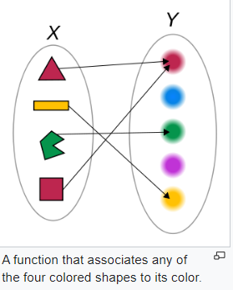


Function
Definition: A function is a relation between two sets, the domain and the co-domain, that maps each element in the domain to exactly one element in the co-domain.
Domain X and co-domain Y can
be arbitrary sets.
X and Y are part of the definition.

Slide 6
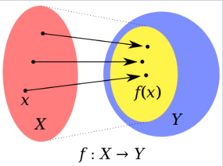
Functions
f is the name of the function and x its argument
Sometimes one considers partial functions where not all x in X have an image under f
The range of f is the set of values in Y it actually takes.

Slide 7
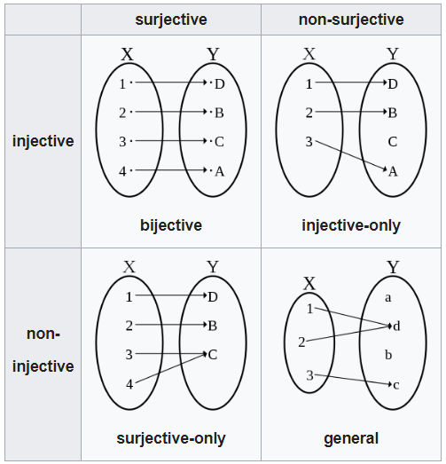
Injection, Surjection and Bijection
Classes of relations between inputs and outputs

Slide 8
Injection, Surjection and Bijection
Injection: one-to-one; each x in X maps onto exactly one y in Y (but perhaps not all such y)
Surjection: each y in Y is image of at least one x in X; the image f(X) covers the co-domain; the range are all elements in the co-domain.
Bijection: “one-to-one correspondence”
→ mapping can be inverted

Slide 9
Composition of Functions
f : X → Y x -> f(x)
g : Y → Z y -> g(y)
g ס f : X → Z x-> g( f( x ) )
Example: X=Y=Z=R f(x) = x² g(x) = -2x
→ g(f(x)) = -2(x²)
also f(g(x)) = (-2x)² = 4x²

Slide 10
Inverse of a Function
f : X → Y x -> f(x) surjective
g : Y → X y -> g(y)
If for all y in Y holds f(g(y)) = y, the function g is the right-inverse of f
Note: this does not imply g(f(x)) = x for all x in X.
If this also holds, the functions are bijective and inverses of each other

Slide 11
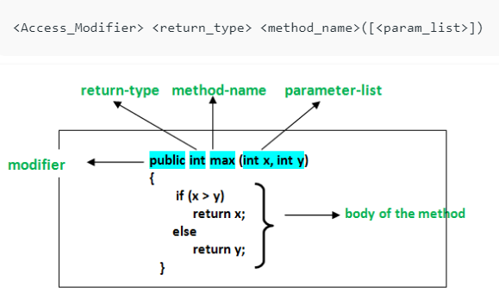
Functions in Computer Science
Mathematical functions correspond with function definitions, procedures or methods in CS

Slide 12
Functions in Computer Science
Parameters (= arguments) have names and a type. The types indicate the set the variables come from.
Return type corresponds with the co-domain
Type modifiers don’t exist in calculus.
A function body is not always part of a Maths function; they can be abstract.

Slide 13
Implicit Functions
In y = f(x) , x is a free variable and y a dependent variable; y depends on x via f
Dependencies can be implicit. The expression
x + y = 1
gives rise to two implicitly defined functions
y = y(x) = 1-x and x = x(y) = 1 – y

Slide 14
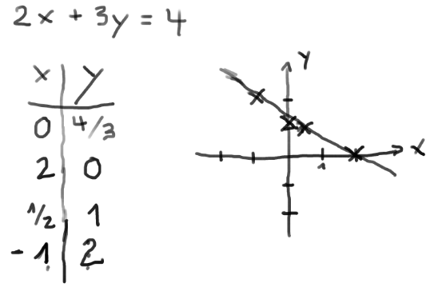
Graph of a Function
2x+3y=4 → y = (4-2x)/3 = 4/3-2/3 x
Compute points using the equation and plot

Slide 15
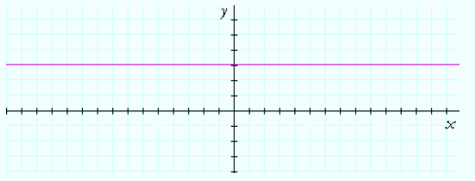
Constant function
y = f(x) = 3 ( = constant)

Slide 16
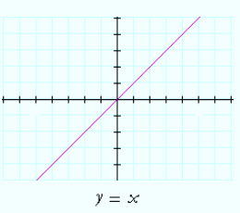
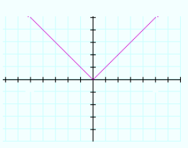
Identity x and absolute value |x|
y = id(x) = x y = abs(x) = |x|
= x if x>=0 and –x else

Slide 17
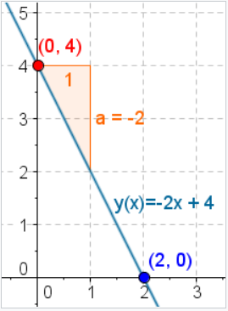
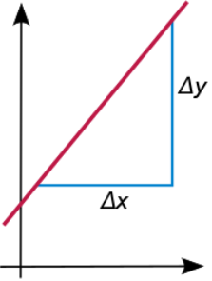

Linear function
f(x) = a x + b
a is the slope
b is the interception with the ordinate (y axis)

Slide 18
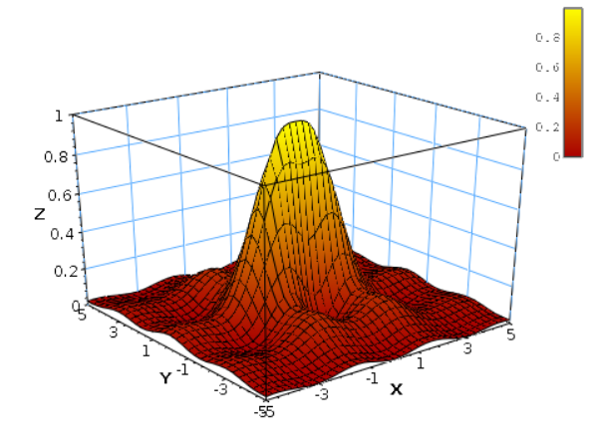
Higher-dimensional Functions
The domain or co-domain can be a Cartesian product
f : R²→ R z = f(x, y) [z is colour coded over 2D plane]

Slide 19
Task 1
f(x) = x²
What are the domain and range ?
Is the function injective, surjective or bijective?
^{Plot the graph}

Slide 20
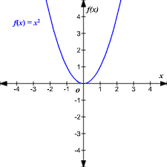
Task 1
f(x) = x²
What are the domain and range ?
Is the function injective, surjective or bijective?
If R -> R , f is not injective and not surjective
If R -> R0+ , f is not injective but surjective
If R0+ -> R0+ , f is injective and surjective, ie bijective

Slide 21
Task 2
f(x, y) = x² + y²
What are the domain and range ?
Is the function injective, surjective or bijective?
^{Plot the graph}

Slide 22
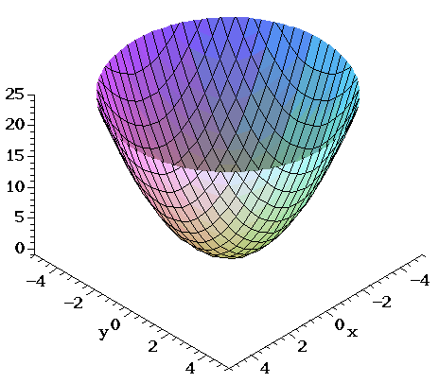
Task 2
f(x, y) = x² + y²
What are the domain and range ?
Is the function injective, surjective or bijective?
^{Plot the graph}

Slide 23
Task 3
f(x, y) = x² - y²
What are the domain and range ?
Is the function injective, surjective or bijective?
^{Plot the graph}

Slide 24
Relations

Slide 25
Covered Topics
Binary and n-ary relations
Relational data bases
Symmetry, transitivity, …
Equivalence Relation
Order Relation
Lattice

Slide 26
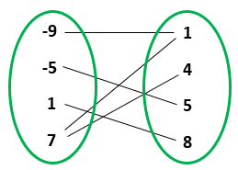
Relation Example
Elements in two sets that are “somehow” related

Slide 27
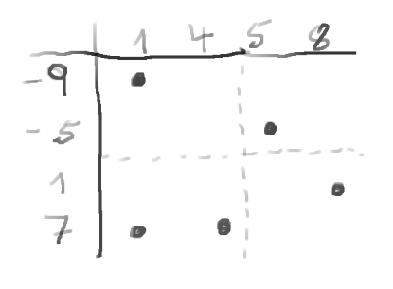
Relation Example
The relation can be expressed by a table

Slide 28
Relation Example
The relation can be expressed by a table
The table is equivalent to a function graph

Slide 29
Relation Example
Not unique in either direction -> not a function

Slide 30
Relation Example
Not unique in either direction -> not a function
Functions are special relations, ie unique mappings

Slide 31
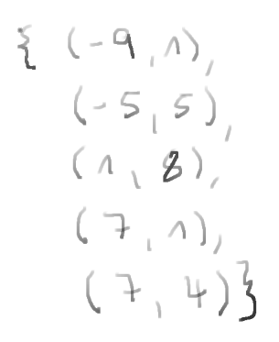
Relation Example
We can also write the relation as a set of tuples

Slide 32
Remember: Cartesian Product of Sets
If A and B are sets the Cartesian Product is the set of all ordered pairs, A x B, aka tuples
A = {1,2} B = {red, white}
AxB = { {1, red}, {1, white},
{2, red}, {2, white} }

Slide 33
Relations
In mathematics a finitary relation over sets X₁, …, X_{n}
  is a subset of the Cartesian Product X₁ × … × X_{n};
  that is, it is a set of n-tuples (x₁, …, x_{n}) consisting of elements x_{i} in X_{i}.
Typically, the relation describes a possible connection between the elements of an n-tuple.
A relation over n sets is also called n-ary

Slide 34
Binary relations*
If X₁=X₂ called homogeneous
otherwise heterogeneous
Homogeneous X = N, Z, R : <, <=, >, ==, divisibility
X a set :
Heterogeneous: (if x is not a set)
*Footnote: Unary relations are just subsets of a set

Slide 35
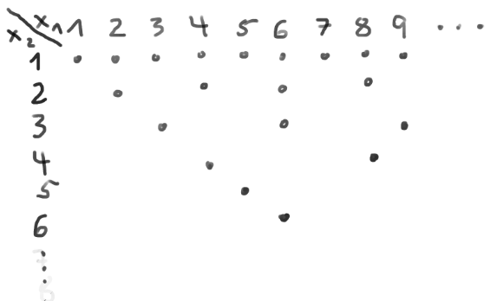
Discrete Relations as Tables
Divisibility example (Graph of a relation)
Divisibility example (Graph of a relation)

Slide 36
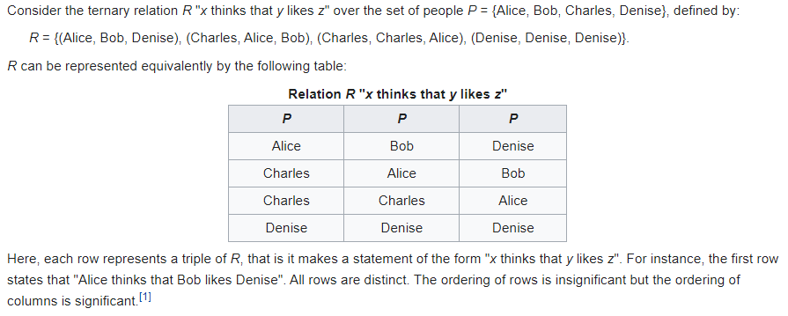
Relations and Data Bases
Relational Databases (‘SQL’) have an algebraic underpinning – relational algebra -> later modules.
Set operations, selections, projections, joins, etc.

Slide 37
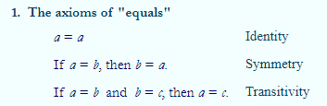
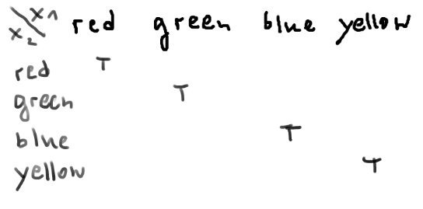
Properties of Relations
Example:
Equality on the set {red, green, blue, yellow} …
.. is reflexive, symmetric and transitive

Slide 38
Properties of Relations
Identity/reflexivity: relation holds for all x x R x
Symmetry: relation holds both ways x R y = y R x
Transitivity: if x R y and y R z then x R z
Example: < on Z (‘smaller than’ on integers)
does ? satisfy identity property
does ? satisfy symmetry
does ? satisfy transitivity

Slide 39
Properties of Relations
Identity/reflexivity: relation holds for all x x R x
Symmetry: relation holds both ways x R y = y R x
Transitivity: if x R y and y R z then x R z
Example: < on Z (‘smaller than’ on integers)
does not satisfy identity property 1 < 1 is false
does not satisfy symmetry 1<2 ok 2<1 false
does satisfy transitivity 1 < 5 < 7

Slide 40
Properties of Relations
Identity/reflexivity: relation holds for all x x R x
Symmetry: relation holds both ways x R y = y R x
Transitivity: if x R y and y R z then x R z
Example: < on Z (‘smaller than’ on integers)
does not satisfy identity property 1 < 1 is false
does not satisfy symmetry 1<2 ok 2<1 false
does satisfy transitivity 1 < 5 < 7
How about <= ?

Slide 41
Equivalence Relations
An equivalence relation is a binary relation that is reflexive, symmetric and transitive.
Equivalence relations partition a set into subsets, so-called equivalence classes, of ‘somehow’ equivalent elements.
Note: A partition cuts the whole set into disjoint subsets.

Slide 42
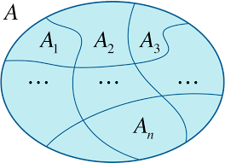
Set Partition
The set A is partitioned into n non-overlapping subsets such that the union of all subsets is A.
Each element of a is covered by exactly one subset

Slide 43
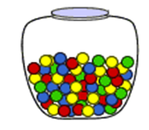

Set Partition : “same colour”
The set A is partitioned into n non-overlapping subsets such that the union of all subsets is A.
Each element of a is covered by exactly one subset

Slide 44
Equivalence Relations
An equivalence relation is a binary relation that is reflexive, symmetric and transitive.
ERs partition a set into subsets, so-called equivalence classes, of ‘somehow’ equivalent elements.
Example: Equality on the numbers
(the equivalence classes are the individual numbers)

Slide 45
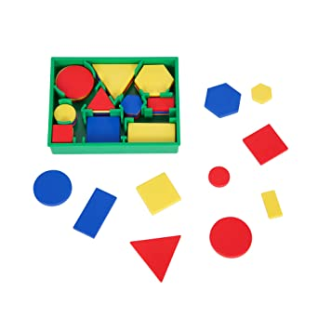
Example: Equivalence Relation
A = { ‘red triangle’, ‘red square’, ‘green square’ …}
Relation: “x has same colour than y”
Identity ok, Symmetry ok, Transitivity ok
Equivalence classes:
“red things”, “squares”,
“small things”, “4 corners”, …

Slide 46
Examples
Which are equivalence relations?
"Has the same birthday as" on a set of people.
"Has the same absolute value" on the set of real numbers
"Has the same cosine" on the set of all angles.
“Has same length” on character strings

Slide 47
Examples
Which are equivalence relations?
"Has the same birthday as" on a set of people.
"Has the same absolute value" on the set of real numbers.
"Has the same cosine" on the set of all angles.
“Has same length” on character strings.
All of them

Slide 48
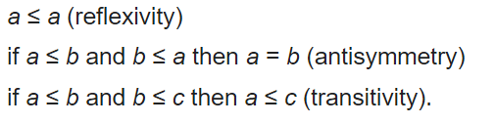
Order Relations
Definition: If P is a set and is a binary relation on P. Then is a partial order on P if it is reflexive, antisymmetric and transitive, ie for all a, b and c in P, we have that:
Examples: The well known orders on N,Z,Q,R

Slide 49
Partially Ordered Sets
A set P with partial order on it is called a partially ordered set or poset.
Why “partially” only ?

Slide 50
Partially Ordered Sets
A set P with partial order on it is called a partially ordered set or poset.
Why “partially” only ?
N,Z,Q,R satisfy connexity: each two elements can be compare by the relation.
For all a,b, in P we have either a b or b a

Slide 51
Partially Ordered Sets
A set P with partial order on it is called a partially ordered set or poset.
Why “partially” only ?
N,Z,Q,R satisfy connexity: each two elements can be compare by the relation.
For all a,b, in P we have either a b or b a
A connex partial order is called a total (or chain) order

Slide 52
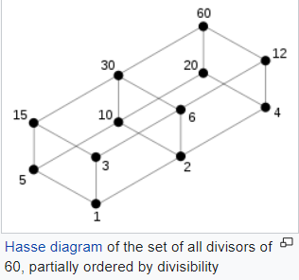
Non-connex Example: Divisibility

Slide 53
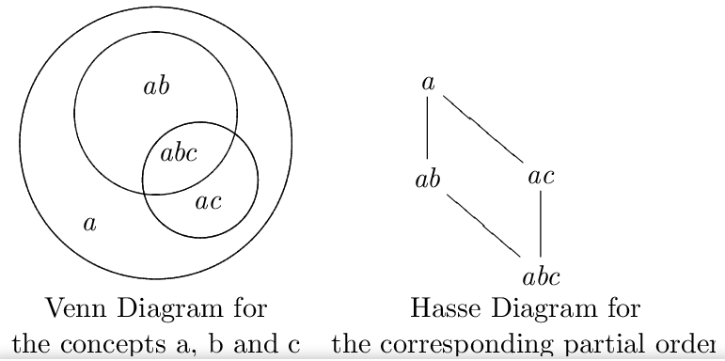
Example: Sets
Assume a,b,c are properties of elements. The total set is partitioned into subsets of different mixes. Left: Venn diagram; Right: Hasse diagram of set inclusions.
Notes:
SMP is total set, all elements that satisfy any of the properties.

Slide 54
Summary
Functions are one of the central Maths concepts
We defined some function properties and special functions
Functions are a subset of relations
Equivalence relations group sets by some property
Order relations induce partial or total order on sets

